Slide 1
Architecture Design Authority
Prepared for Client Name Your name here Date
Integration with QCBS’s new CRC interface
(Business Unit: Technology)
22-08-2024

Slide 2
Contents
Solution Architecture
Context
Architecture principles applied
System components
Workflow description
Target state architecture
Integration strategy
Monitoring requirements
Other non-functional requirements
Risk and mitigation strategy
Recommendations

Slide 3
Solution Architecture

Slide 4
Context
The Bank of Mozambique (BM), within the scope of its strategic objective to modernize and automate business processes, is implementing a new integrated technological infrastructure that supports all its business processes and complies with international standards.
It was in this context that on 02/01/2023, BM presented the project to the National Financial System (SFN) to promote the adaptation of the changes required by the new core banking solution (Meticalnet) in the ICSF systems.
The Bank of Mozambique requires that all CIFS start sending data related to the daily remittance of credit responsibilities through the Application Programming Interface of their new Central Banking System (QCBS).
This document aims to present the proposed solution for integrating the Standard Bank’s internal CRC reporting processes/workflows with the QCBS platform.

Slide 5
Architectural principles applied
Principle 1: Always on, Always secure
Offer robust, real-time solutions designed to withstand unforeseen challenges, while prioritizing security measures, authentication, and authorization protocols for risk management.
Principle 2: Commerciality
Drive a commercially sound approach to architecture to support the organisation’s economic objectives, considered over the short and long-term life expectancy of the solution.
Principle 3: Iterative delivery
Support organisational driven iterations of delivery towards meaningful outcomes which enable business value, and value for the customer.
Principle 4: Appropriate architecture
An architecture that seeks to reconcile current constraints with future opportunities by addressing the trade-offs between immediate organizational needs and long-term value outcomes.

Slide 6
System Components – Target state
File Transfer Protocol (FTP) Client : software or a platform that enables users to transfer digital files between different systems, devices, or users. For this implementation this role will be played by FileZilla.
Enterprise Service Bus: serves as a central communication hub, enabling seamless and efficient communication between various applications, services, and systems. It enhances scalability, reusability, and flexibility in software integration, streamlining business processes, reducing complexity, and promoting a more agile and responsive IT ecosystem. For this implementation this role will be played by IBM APP Connect Enterprise®.
SMS services stack: it acts as an intermediary between the application or system and the mobile network, enabling the transmission of text messages over the cellular network infrastructure. For this implementation this role will be played by Blume (Standard Bank Mozambique’s SMS Gateway).
Monitoring and Advanced Observability platform: software solution designed to monitor, analyze, and gain insights into the performance, availability, and behavior of IT systems, applications, networks, and infrastructure components. For this implementation this role will be played by Dyna Trace and Grafana.

Slide 7
Workflow description
Credit Master Data, Credit Operations, Warranties, and Credit Guarantee data are currently being extracted from multiple sources, after which they are curated and consolidated into an Excel spreadsheet.
The Risk Capabilities team will then convert the consolidated Excel spreadsheet into a .csv file. This process will run daily. Upon generating the .csv file, the Risk Capabilities team will use FileZilla to upload the file to a directory on the IBM ACE host.
The FileInput node on IBM ACE will have a polling mechanism that detects whenever a new file is posted, after which it must fetch the file for processing. Processing will consist of parsing and mapping the content of the .csv files to QCBS’s JSON APIs.
The HTTPRequest node will be responsible for invoking the JSON APIs. There will be four (4) different APIs, namely:
Credit Master Data API
Credit Operations API
Warranties API
Credit Guarantee API
Note that the JWT/OAuth APIs are excluded from the list above.
Upon receiving the JSON responses, IBM ACE will parse and insert the data into a database. Once all responses have been received, ACE will retrieve the data from the database, transform it into CSV format, write it to a CSV file, and send the CSV file via email to the Risk Capabilities team.
The CSV files will include the message ID and response code from all requests processed by the Central Bank.

Slide 8
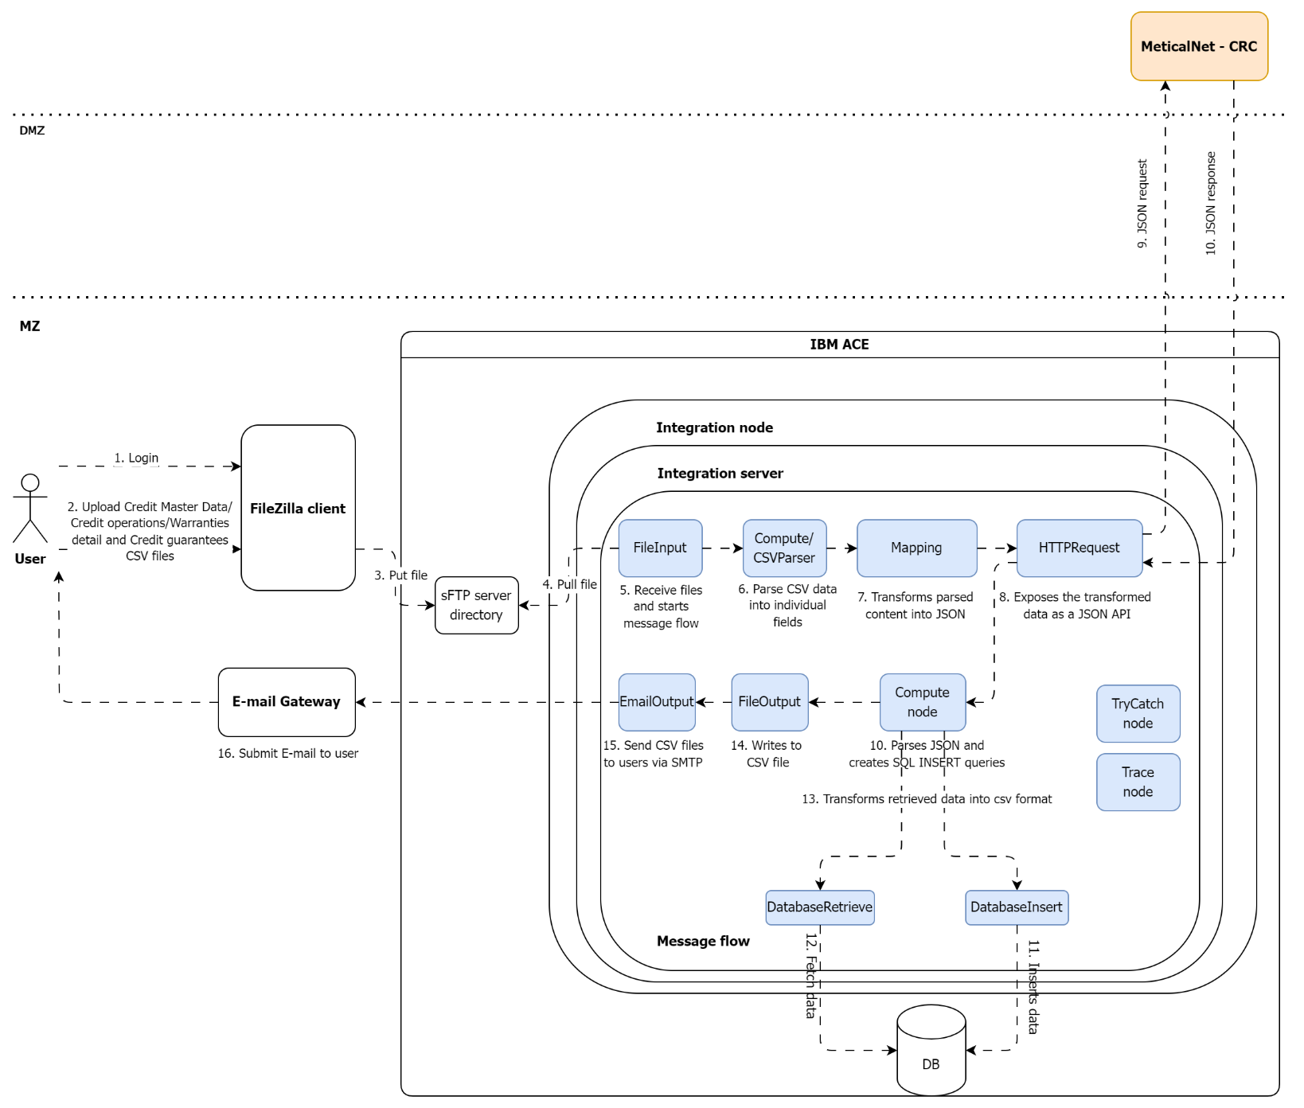
Target state architecture

Slide 9
Integration strategy
Target state architecture:
FileZilla client will be used to upload the Credit Master Data, Credit Operations, Warranties and Credit guarantee Excel files to IBM ACE’s sftp directory.
As soon as a file is copied to the sFTP directory, IBM ACE’s message flow will kick in:
The FileInput node will read the file and push it to JavaCompute node.
A compute or CSVParser node will be used parse the content of the csv files.
The mapping node will transform the parsed content into a JSON file.
The HTTPRequest node will:
invoke a JSON API request to Banco de Moçambique.
receive the JSON API response from Banco de Moçambique.
Submit JSON API response to JSON Parser.
The JSON response will be sent to a compute node that will be responsible to extract the relevant fields (message id and response code) and to create SQL INSERT queries to insert them to a MS-SQL server or PostgreSQL DB. A DataInsert node will be used to insert the data to the DB.
Once IBM ACE receives the response for all requests sent, it shall trigger a fetch data event by using a DatabaseRetrieve node.
A compute node will be used to transform the data to CSV format.
A CSV file will be created by the FileOutput node.
Once the file is created, an E-mailOutput node will be used to submit a SMTP request to the E-mail Gateway.

Slide 10
Integration strategy
Target state architecture:
Audit logs:
IBM ACE host and platform shall log all transactions and operations. This includes but is not limited to sFTP user authentication logs as well as details about the uploaded files.
There will be no retry logic. If the API request fails the process will have to be repeated.
Security:
Secured ftp connections shall be used to upload the files.
Files shall be removed after processing?
JWTs/OAuth shall be used to authenticate and authorize the Metical Net and SMS GW API requests.
IPSec tunnel shall be used to secure the communication with Banco de Moçambique.

Slide 11
Monitoring requirements
Database performance | Database infrastructure | Services
Response times Throughput Failures/Failure rates Failing statements Database availability (failed database connect vs Total database connects) Locks : Deadlocks, Timeouts, Waits for lock, Wait time. | CPU monitoring Memory usage Performance monitoring: Execution times IO monitoring Session monitoring (total sessions/active sessions) Tablespace monitoring (total/free space) | Response times Throughput Failures/Failure rates CPU consumption

Slide 12
Other non-functional requirements
Scalability and availability:
All components in the value chain must be redundant, highly available and fault-tolerant.
IAM security
Logical access management: ensure that application is onboarded on MyAccess, for user access request lifecycle.
Authorisation: The Standard Bank Group Toolbox - Internal Staff Authentication Standard - All Documents (sharepoint.com)
Authentication: The Standard Bank Group Toolbox - Internal Staff Authentication Standard - All Documents (sharepoint.com)
Privileged access management: The Standard Bank Group Toolbox - Privilege Access Management (PAM) Functional Standard - All Documents (sharepoint.com)

Slide 13
Other non-functional requirements
Integration layer security
API security: The Standard Bank Group Toolbox - API - All Documents (sharepoint.com)
Network security: Group Information Security (GIS) - Network Technical Security Policy v2.0.pdf - All Documents (sharepoint.com),
According to article 28 1.f) from notice 2 GBM/2024 (‘Directrizes de gestão de risco e resiliência cibernética’), all Credit Institutions and Financial Societies (CIFS) secure their connections with external systems using secured Virtual Private Networks (VPNs).
Data protection: Data Protection Functional Security Standard V1.5 (Final Draft).pdf
Data at rest: data at rest (stored in the DBs) must be encrypted using the AES-256.
Data in transit: for webservices the protocol to be used is TLS 1.2 or above combined with the ciphers approved by SBGs Information Security team.

Slide 14
Other non-functional requirements
Infrastructure security
Servers:
All servers must be hardened according to SBG security standards for specific OS version that will be deployed.
Servers OS must have security agents installed (Anti-Malware, EDR (Endpoint Detection and Response) agents and DLP (Data Loss Prevention)). Standard Bank is using trellix EPO.
All servers must be integrated with a PAM solution – CyberArk
All servers logs must be sent to IBM QRADAR SIEM, for security events monitoring
Databases: Microsoft SQL Server 2019 Technical Security Standard - v0.2.pdf

Slide 15
Other non-functional requirements
Audit and logging: Cyber Logging and Monitoring Functional Standard 2022 v1.2.pdf
All code that will be deployed internally must be pass through the DevSecOps practices: source code vulnerability analysis (SAST), 3rd party dependencies vulnerability analyses (SCA), container image scan and Dynamic application security testing. Functional Security Standard - DevSecOps - v1.2.pdf
Application container imagens must be scanned for vulnerabilities and remediated before deployment. Functional Security Standard - DevSecOps - v1.2.pdf

Slide 16
Risk and mitigation strategies
Risk | Description | Mitigation strategy
Incorrectly formatted CSV files | File structure and values do not match what the parser and QCBS is expected to receive resulting in message processing errors. | IBM ACE shall generate error messages with suggestive descriptions which shall be e-mailed to the Risk Capabilities team. Risk Capabilities team to valida content and structure of the files before uploading them to the system.
Access to folders/directories on IBM ACE | Risk capabilities sFTP user accounts have access to the entire directory structure of the sFTP server. This may expose the system to deliberate or non-deliberate changes that may harm the environment. | Apply principle of less privilege: users can only have access to the directory where they are supposed to put the .csv files.
Failed or timed out JSON requests | Some of the JSON requests sent to QCBS fail or time out. | Error file must be sent to Risk Capabilities team. Risk capabilities shall correct the records (if applicable), filter the failed and timeout requests and re-submit the files.
Launching the service without accommodating minimum monitoring requirements | Lack of visibility over the service and server health which may hinder the Bank’s ability to swiftly react to incidents. | Perform daily checklists on the entire stack until all monitor controls are in place.
Launching the service without accommodating minimum security requirements | Difficulty in troubleshooting service affecting incidents. Exposure of sensitive information and to cyber theft. | TBC

Slide 17
Recommendations
The EA team advocates for leveraging existing components (existing IBM ACE Prod instance) to reduce the project cycle times. This aligns with principles# 2 (commerciality) and #4 (appropriate architecture).
The EA team also believes that the Bank should ensure that an implementation roadmap for the target architecture is put in place to allow a gradual transition to the ideal state (principle# 3). The ideal state is a state where the entire CRC reporting value chain is automated.
Lastly, although there is some urgency to get the service over the line, it is important comply with Bank’s Always On and Always Secure guidelines (principle# 1). Failing to do so may result in the launch of a faulty solution that does not comply with the Bank’s minimum quality standards.

